Slide 1
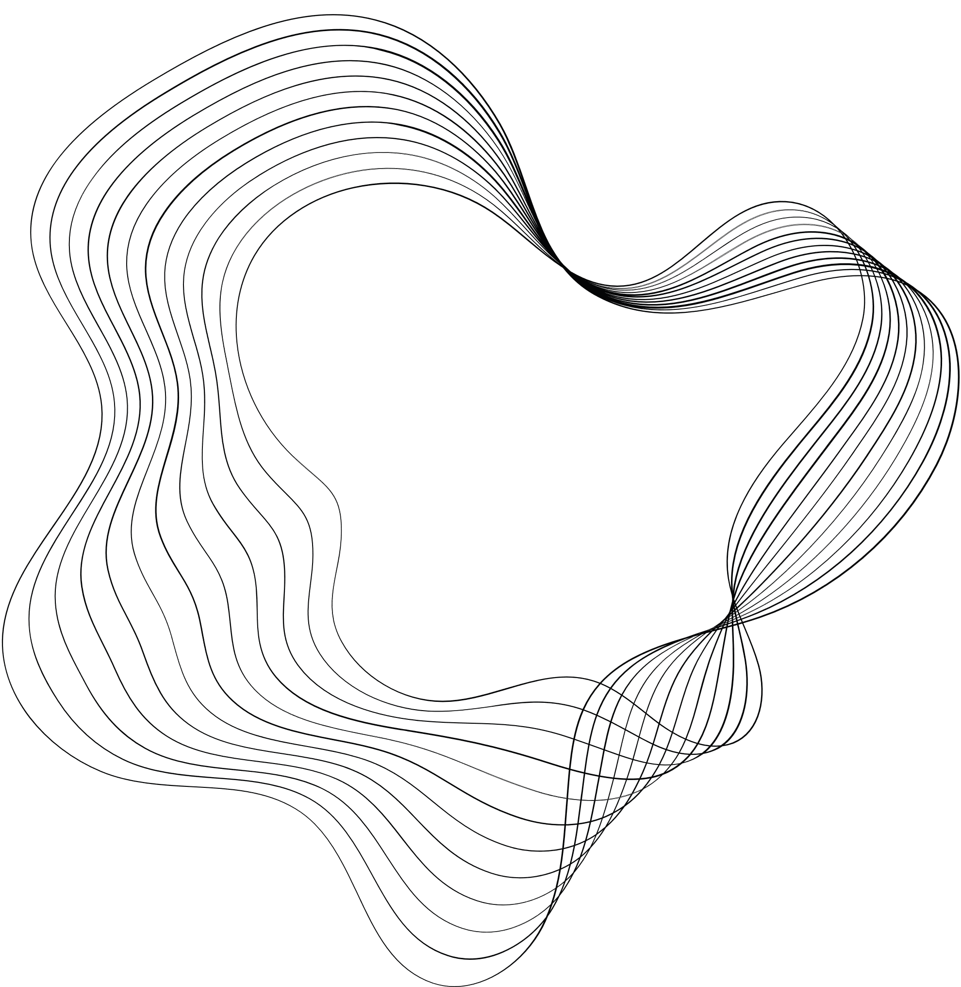

Computations in Chemical Engineering:
Graphs & Monte Carlo

Slide 2
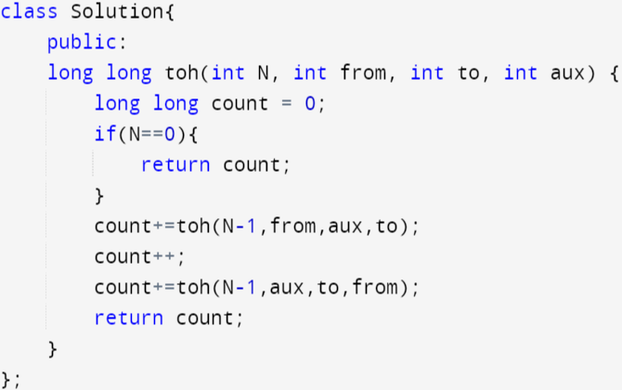
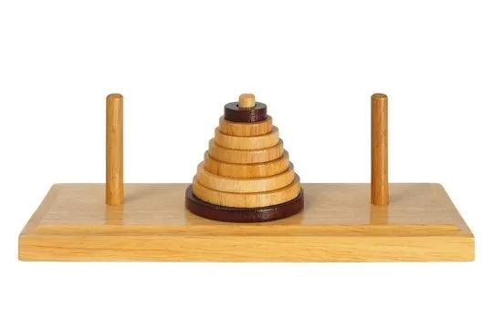
Recursion

Slide 3


Vector Stack & Queue
Vector: Dynamic arrays
Stack : First in last out data structure
Queue: First in first out
Implemented stack using queue and vice versa

Slide 4
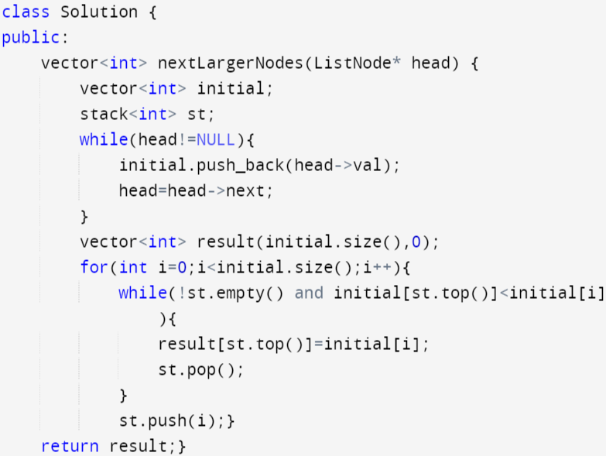
Next greater element

Slide 5
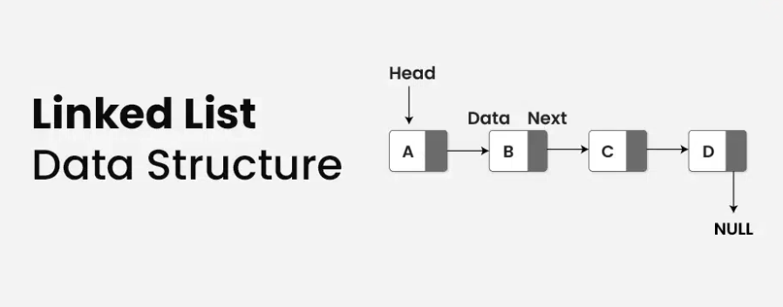

Slide 6

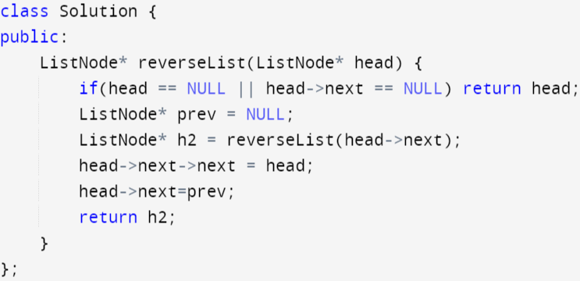
Reversing a linked list

Slide 7
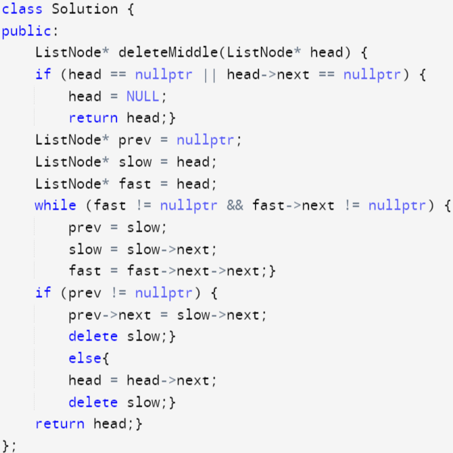
Deleting the middle node

Slide 8
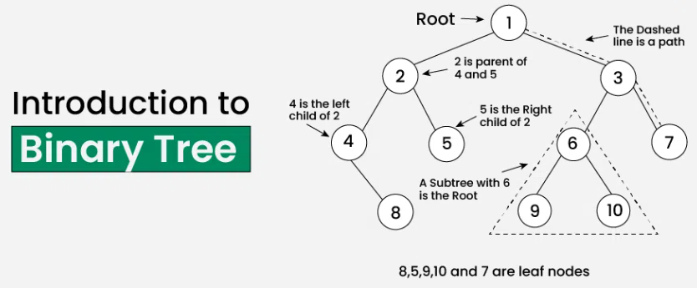
Constructed binary tree from preorder
and postorder traversals

Slide 9
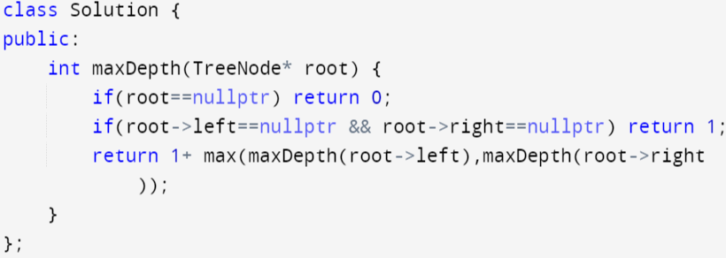
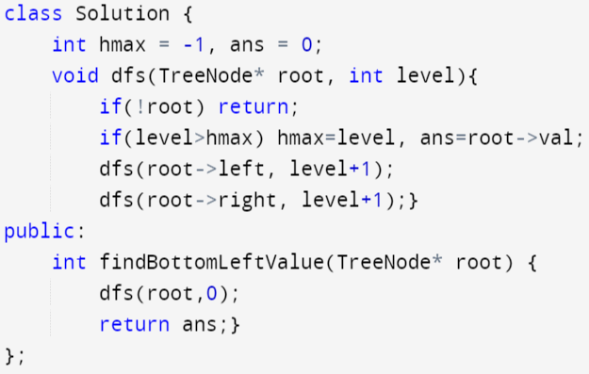
Maximum depth of
binary tree
Bottom left tree
value

Slide 10
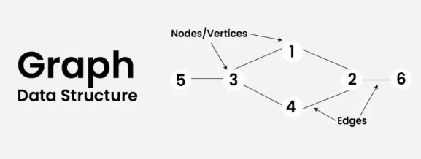

Slide 11
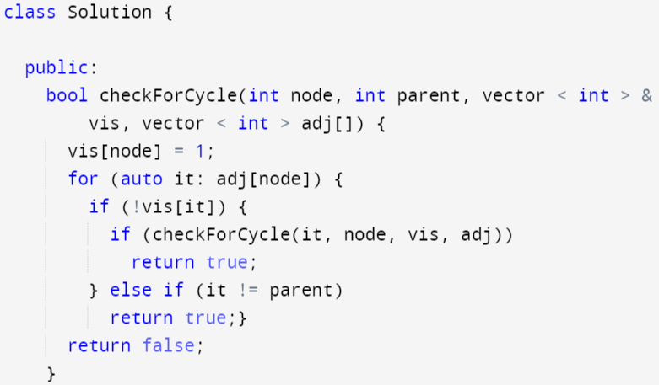
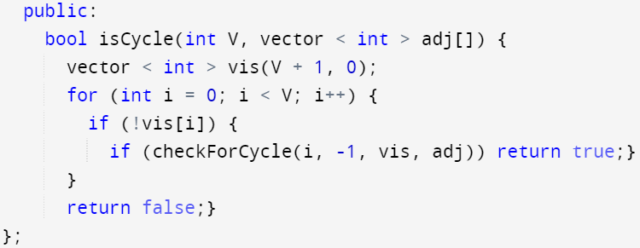
Cycle detection in undirected graph using DFS

Slide 12
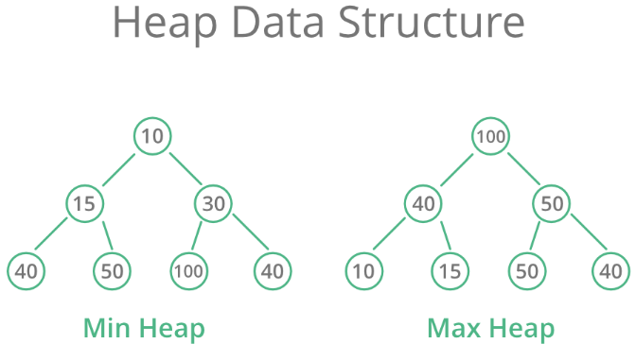

Slide 13

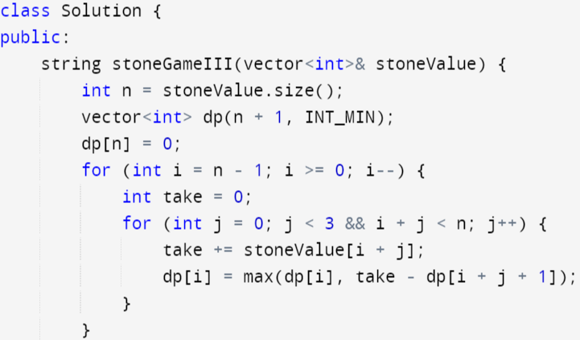
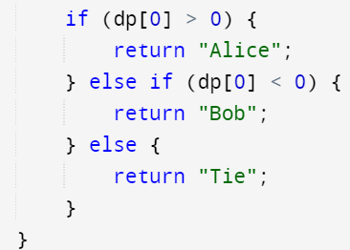
Mid term evaluation
Doc on plasma djikstars
Stone game

Slide 14
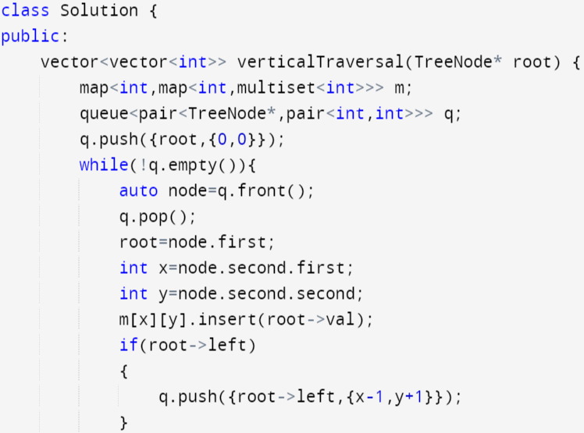
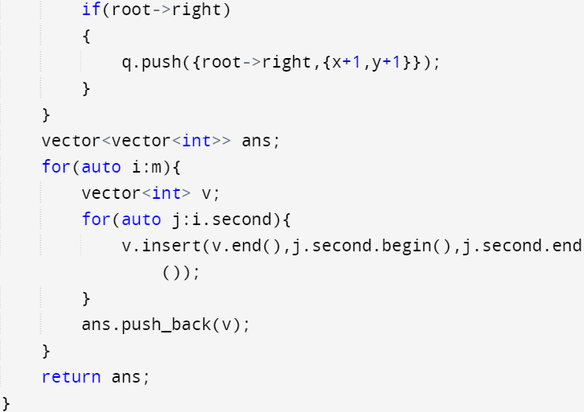
Vertical order traversal of a binary tree

Slide 15
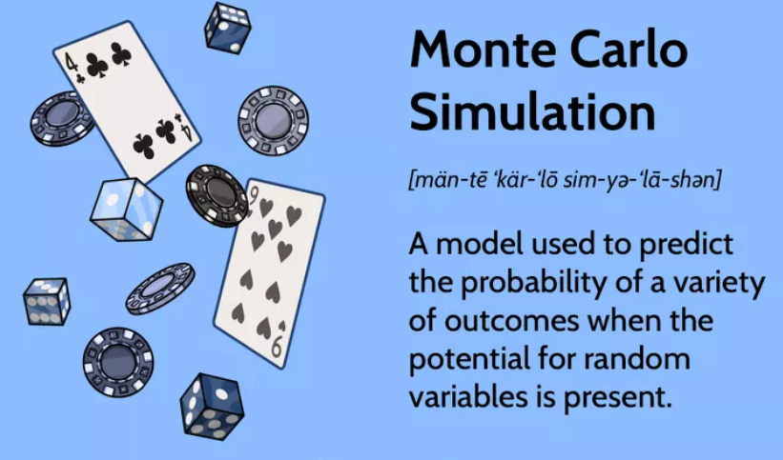

Slide 16
Week 1: Basic Terminologies and Distribution
Week 2: Monte carlo & its methods
Discrete inverse transform
Discrete accept reject
Week 3: Continuous accept reject
Assignment to form ternary diagram for a
mixture using raoults law and stochastic approach

Slide 17
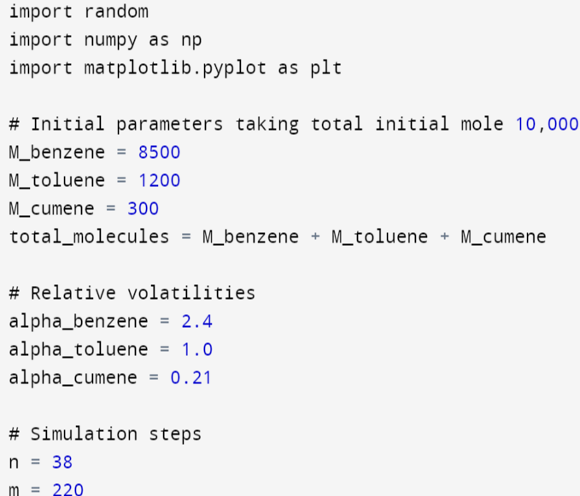
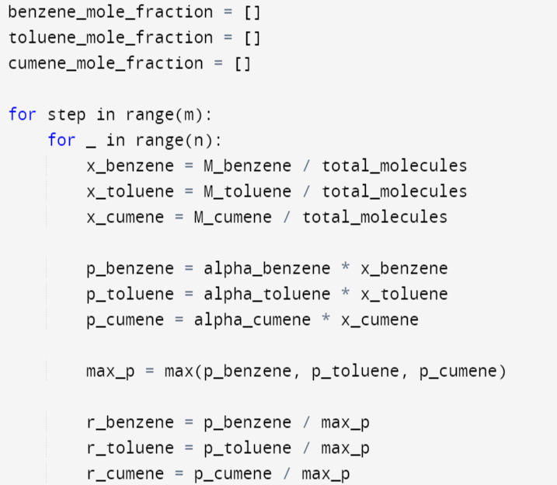
Assignment

Slide 18
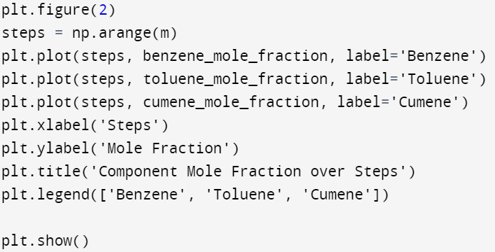
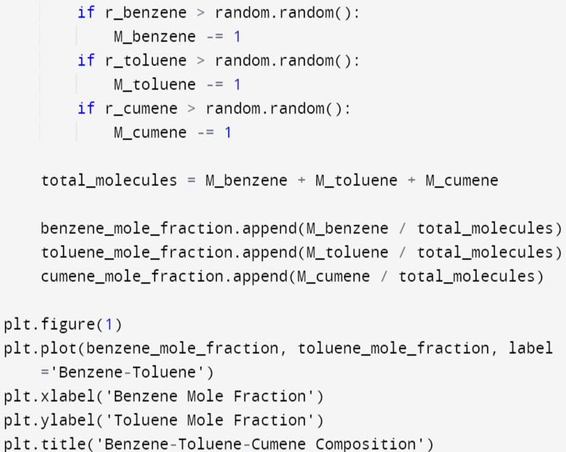
Assignment

Slide 19
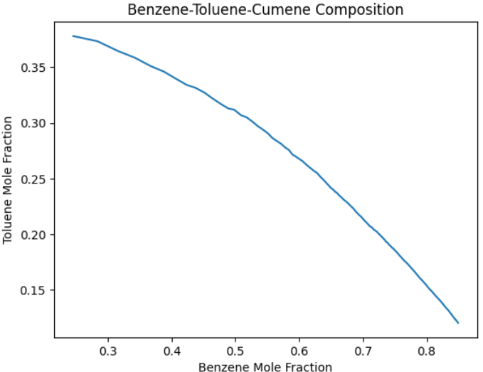
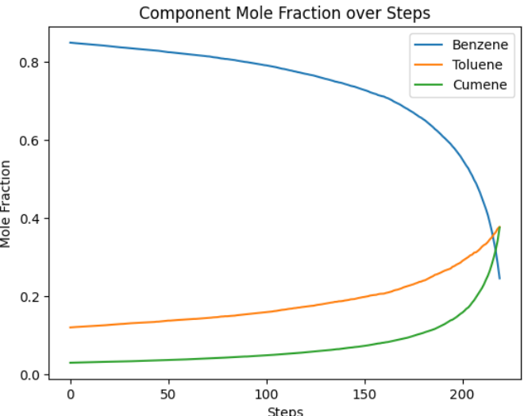
Assignment

Slide 20
Thank you!
Priyanshu Kamde (220494)

